Slide 1
THE ROLE OF RECENT SPECIATION IN MODERN DYNAMICS OF VERTEBRATE DIVERSITY

Slide 2
PRESENT-DAY DIVERSITY DYNAMICS OF TETRAPODS
Are species in “cradles” speciating faster than in “museums”?

Slide 3
PRESENT-DAY DIVERSITY DYNAMICS OF TETRAPODS
Are species in “cradles” speciating faster than in “museums”?
Stebbins 1974
regions of high instability, heterogeneity and species turnover
regions of long-lasting environmental stability and taxonomic diversity

Slide 4
PRESENT-DAY DIVERSITY DYNAMICS OF TETRAPODS
Are species in “cradles” speciating faster than in “museums”?
Stebbins 1974
regions of high instability, heterogeneity and species turnover
regions of long-lasting environmental stability and taxonomic diversity
High phylogenetic relatedness of species
Distantly related species

Slide 5
PRESENT-DAY DIVERSITY DYNAMICS OF TETRAPODS
Are species in “cradles” speciating faster than in “museums”?
Stebbins 1974
regions of high instability, heterogeneity and species turnover
regions of long-lasting environmental stability and taxonomic diversity
High phylogenetic relatedness of species
Distantly related species
HYPOTHESIS
High speciation rates
Low speciation rates

Slide 6
METHODOLOGICAL WORKFLOW
Species distribution data
Phylogenetic data

Slide 7
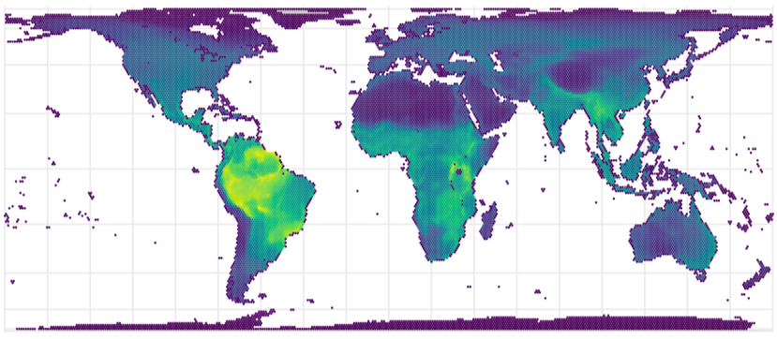
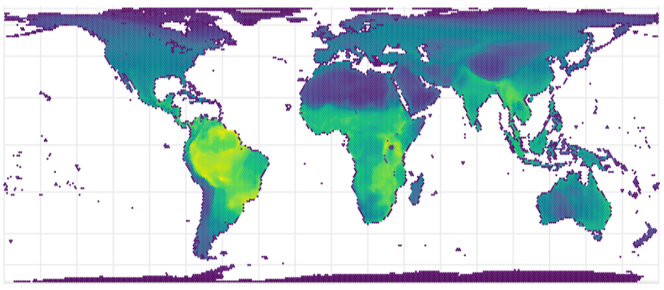
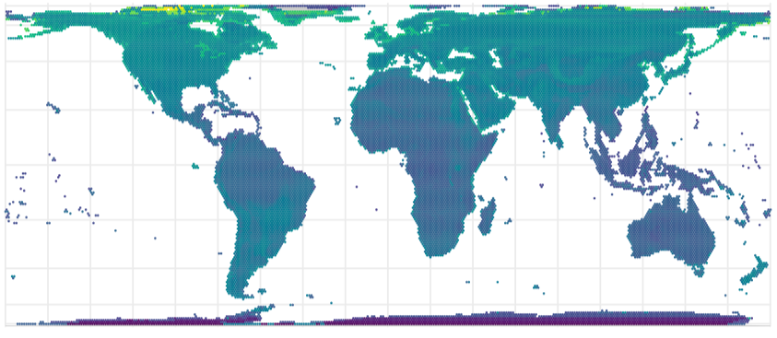
METHODOLOGICAL WORKFLOW
Species distribution data
Phylogenetic data
Species richness (SR)
Phylogenetic diversity (PD)
Speciation rate (DR)

Slide 8
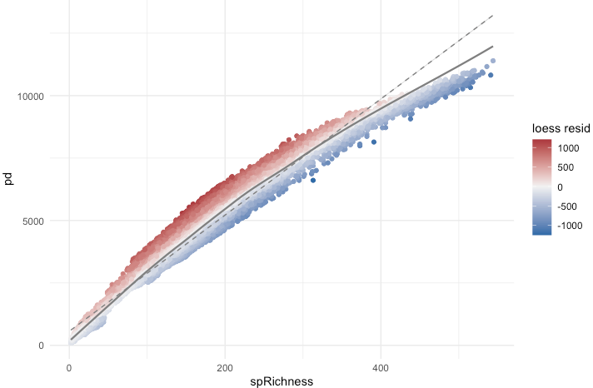
METHODOLOGICAL WORKFLOW
Species distribution data
Phylogenetic data
Species richness (SR)
Phylogenetic diversity (PD)
Speciation rate (DR)
PD ~ SR

Slide 9
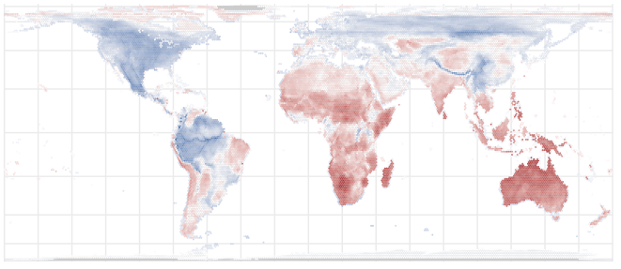
METHODOLOGICAL WORKFLOW
Species distribution data
Phylogenetic data
Species richness (SR)
Phylogenetic diversity (PD)
Speciation rate (DR)
PD ~ SR
Map residual PD
Take residuals

Slide 10
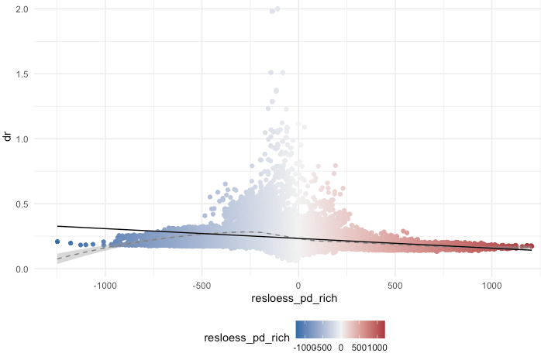
METHODOLOGICAL WORKFLOW
Species distribution data
Phylogenetic data
Species richness (SR)
Phylogenetic diversity (PD)
Speciation rate (DR)
PD ~ SR
Map residual PD
DR ~ resPD
Take residuals

Slide 11
HYPOTHESIS
CRADLE
Speciation rate
MUSEUM
Residual PD

Slide 12
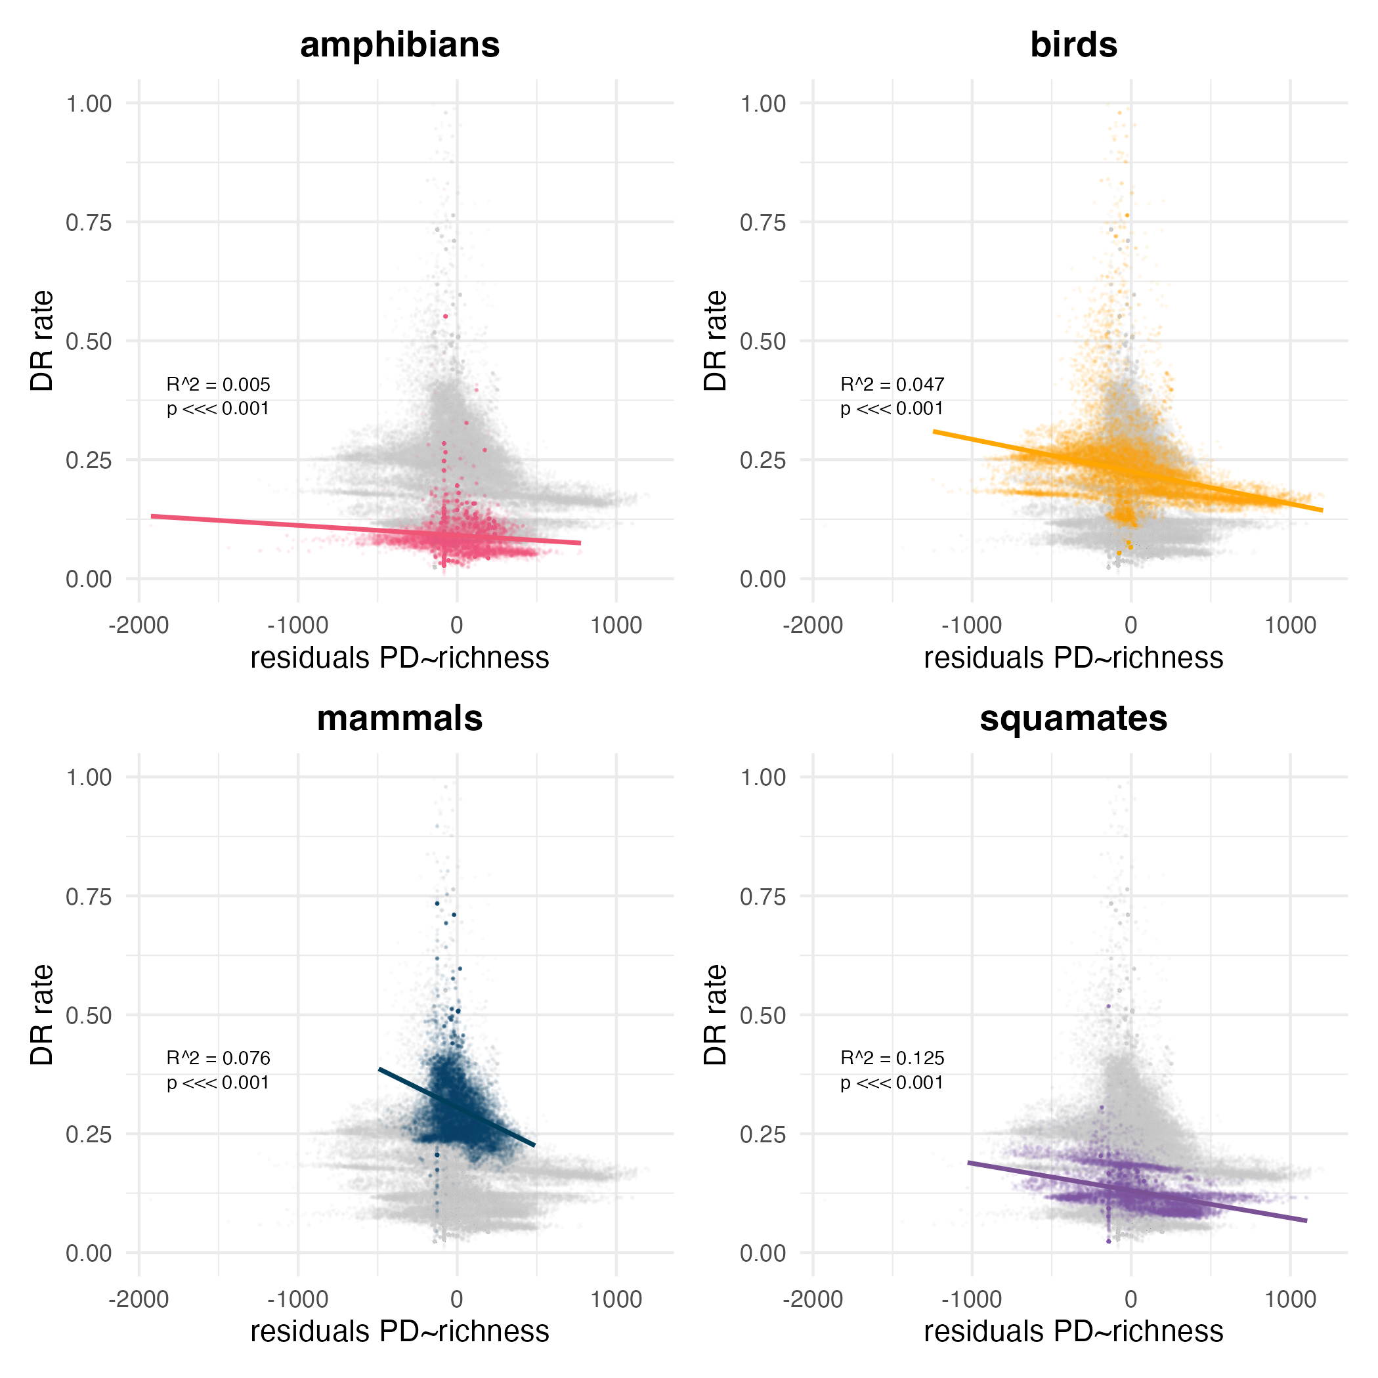


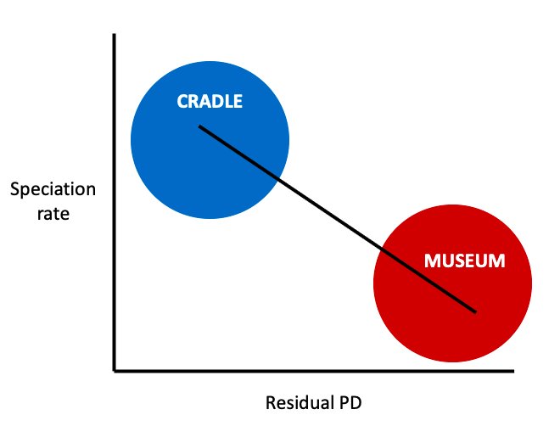


RESULTS
Negative but weak relationship

Slide 13
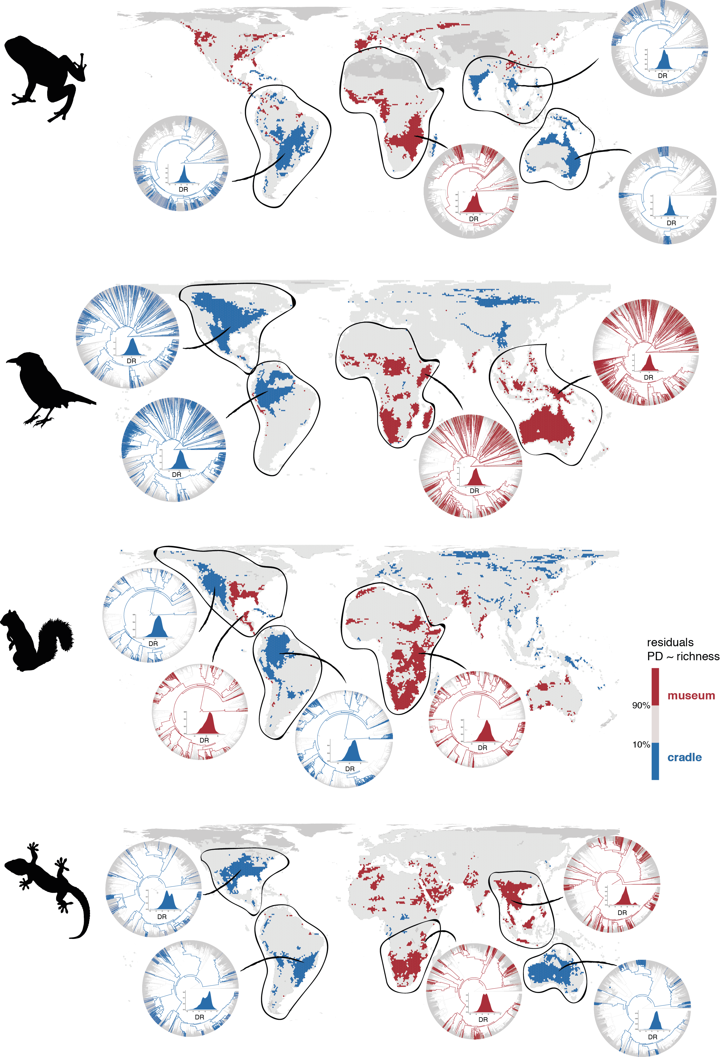
CHARACTERIZATION OF GEOGRAPHIC PATTERNS OF DIVERSITY DYNAMICS
Identification of museums and cradles
Potentially differential factors?
Time (LTTs), speciation rate, environment (climatic space)

Slide 14
SPECIATION RATE

Slide 15
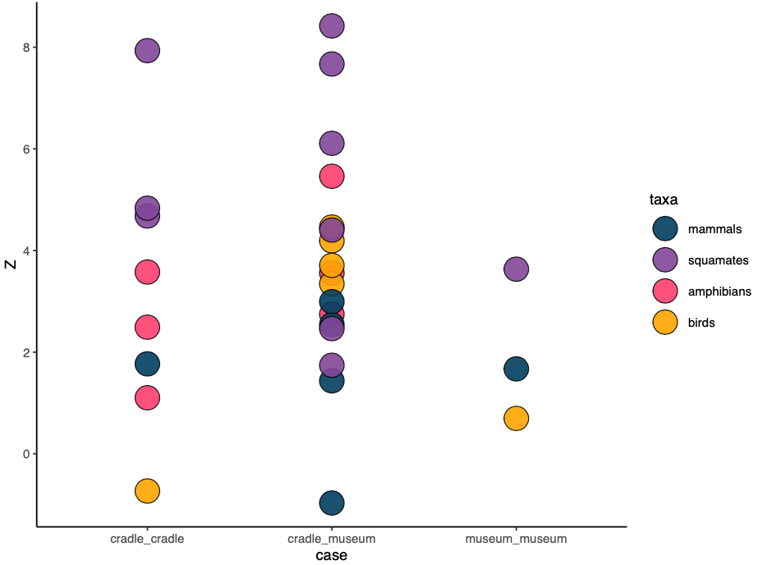
SPECIATION RATE DIFFERENCE
Comparison of speciation rates between cradles and museums (are the differences between cradles and museums larger than between cradles and between museums?). The difference found between museums and cradles is not that different to the difference found between cradles and between museums.

Slide 16
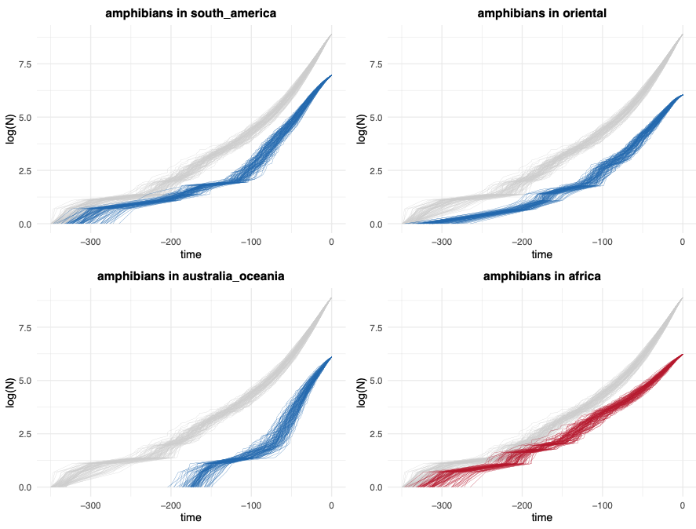
TIME

Slide 17
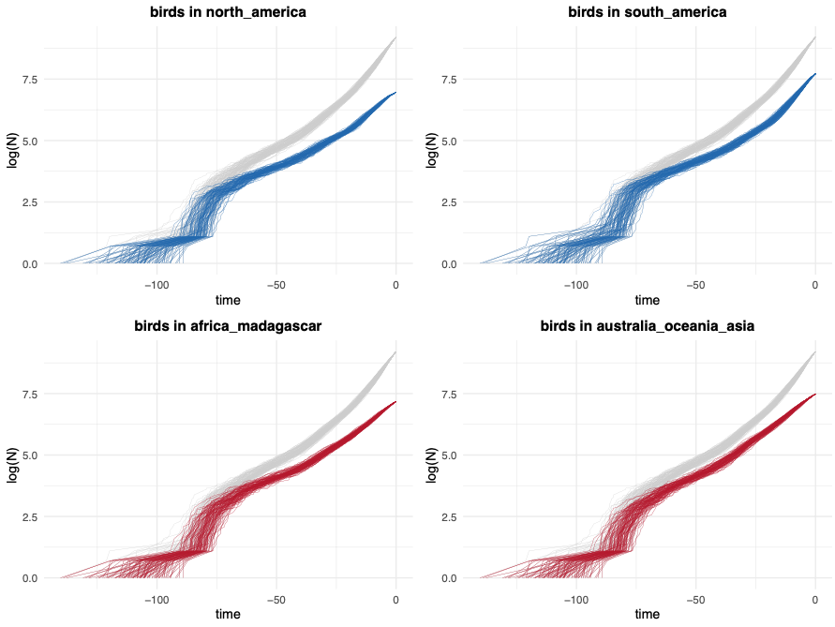
TIME

Slide 18
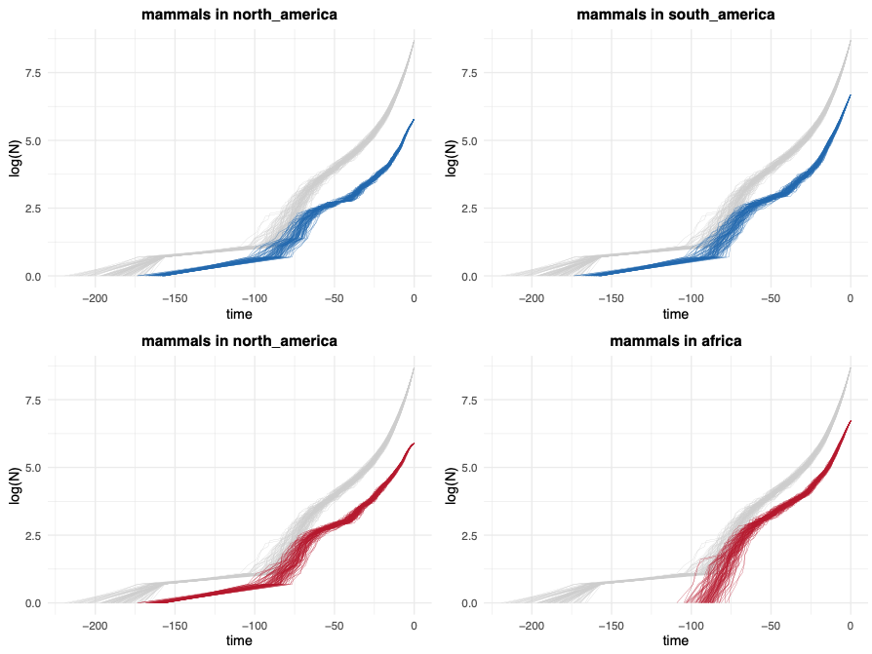
TIME

Slide 19
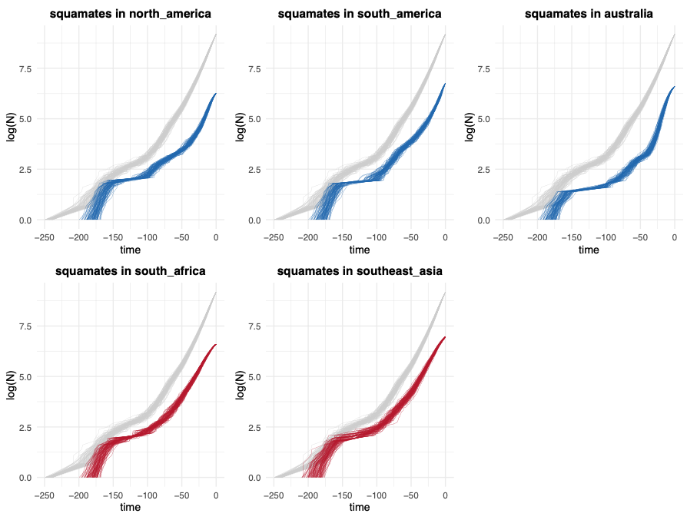
TIME

Slide 20
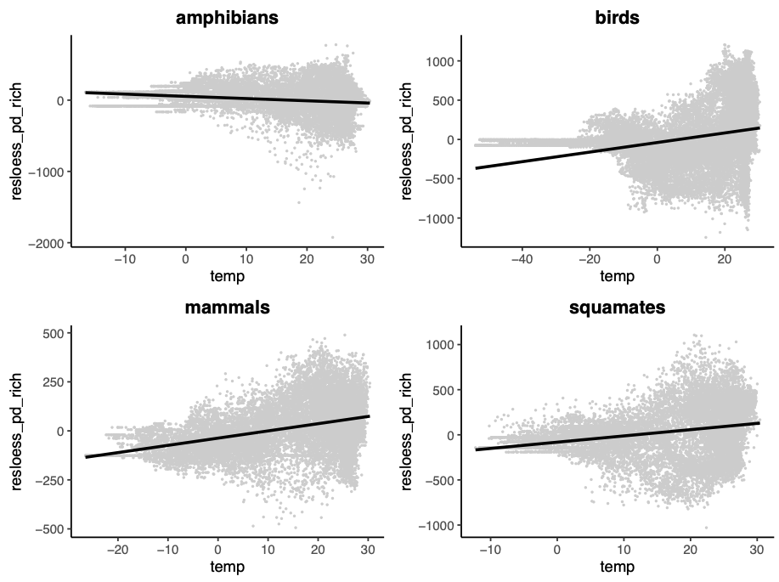
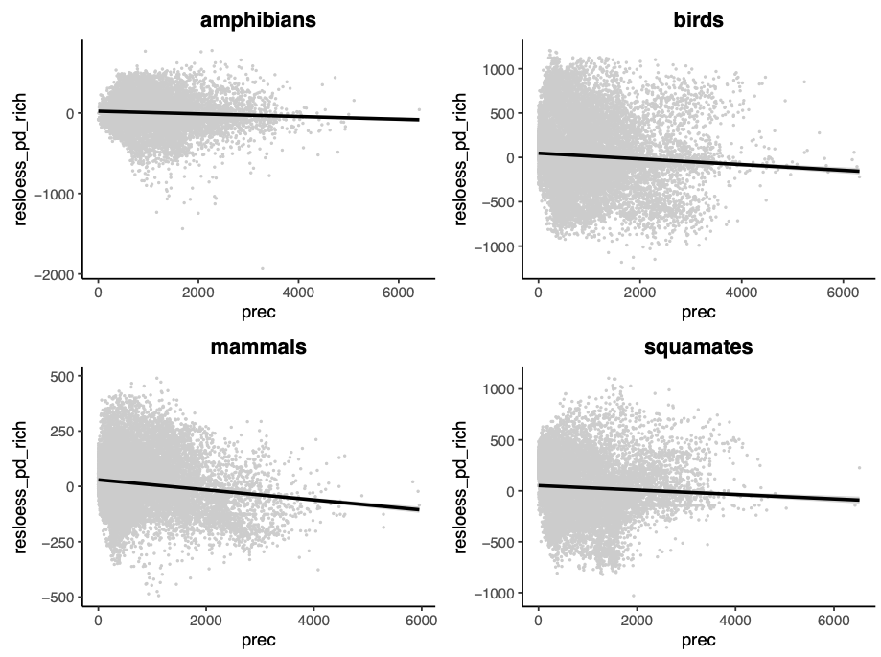
ENVIRONMENT
Temperature
Precipitation
R² = 0.03
R² = 0.004
R² = 0.09
R² = 0.005
R² = 0.14
R² = 0.07
R² = 0.017
R² = 0.004

Slide 21
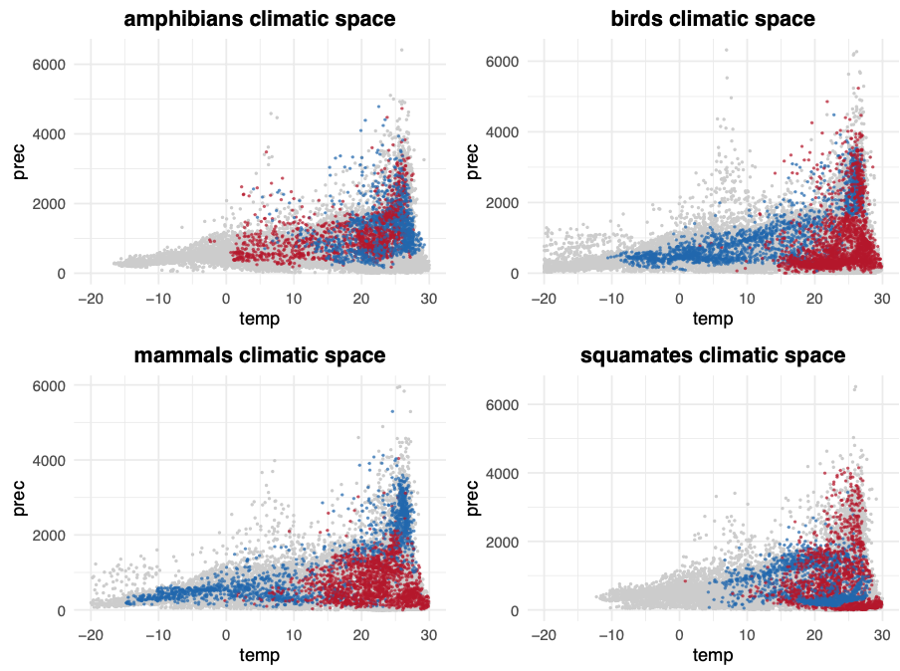
ENVIRONMENT
Temperature
Precipitation
R² = 0.03
R² = 0.004
R² = 0.09
R² = 0.005
R² = 0.14
R² = 0.07
R² = 0.017
R² = 0.004

Slide 22
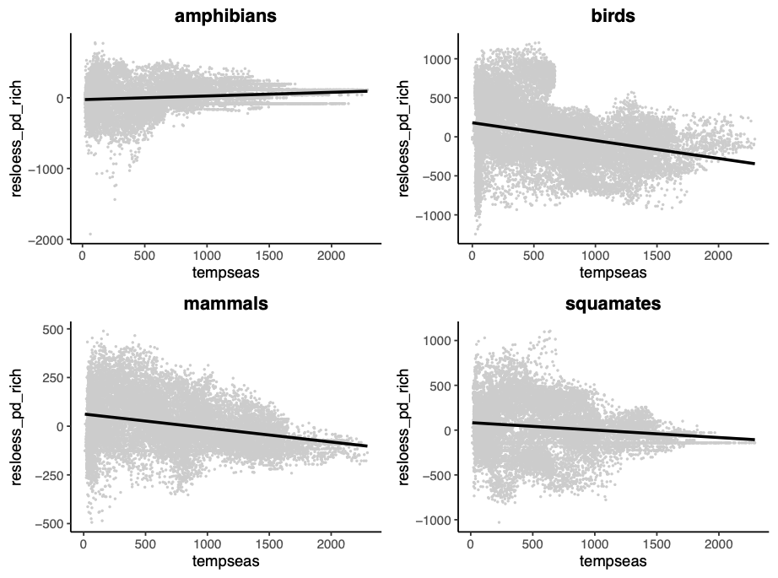
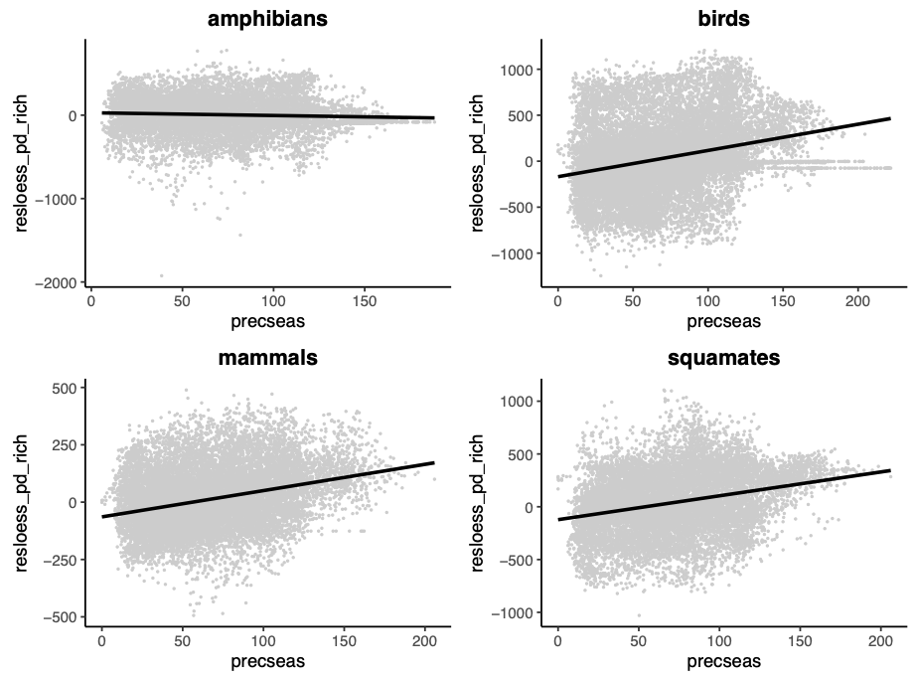
ENVIRONMENT
Temperature
Precipitation
R² = 0.03
R² = 0.004
R² = 0.09
R² = 0.005
R² = 0.14
R² = 0.07
R² = 0.017
R² = 0.004
Temperature seasonality
Precipitation seasonality
R² = 0.09
R² = 0.018
R² = 0.003
R² = 0.077
R² = 0.08
R² = 0.018
R² = 0.092
R² = 0.080

Slide 23
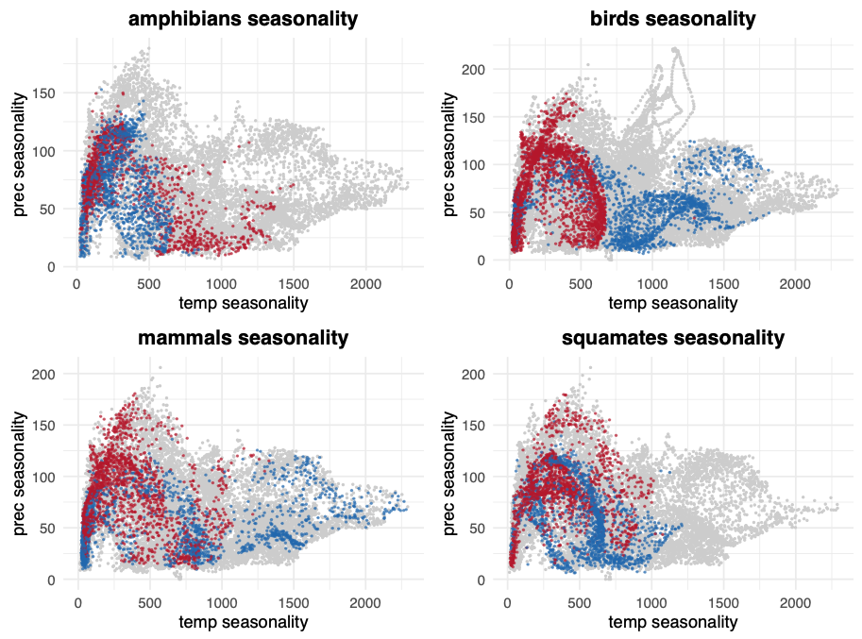
ENVIRONMENT
Temperature
Precipitation
R² = 0.03
R² = 0.004
R² = 0.09
R² = 0.005
R² = 0.14
R² = 0.07
R² = 0.017
R² = 0.004
Temperature seasonality
Precipitation seasonality
R² = 0.09
R² = 0.018
R² = 0.003
R² = 0.077
R² = 0.08
R² = 0.018
R² = 0.092
R² = 0.080

Slide 24
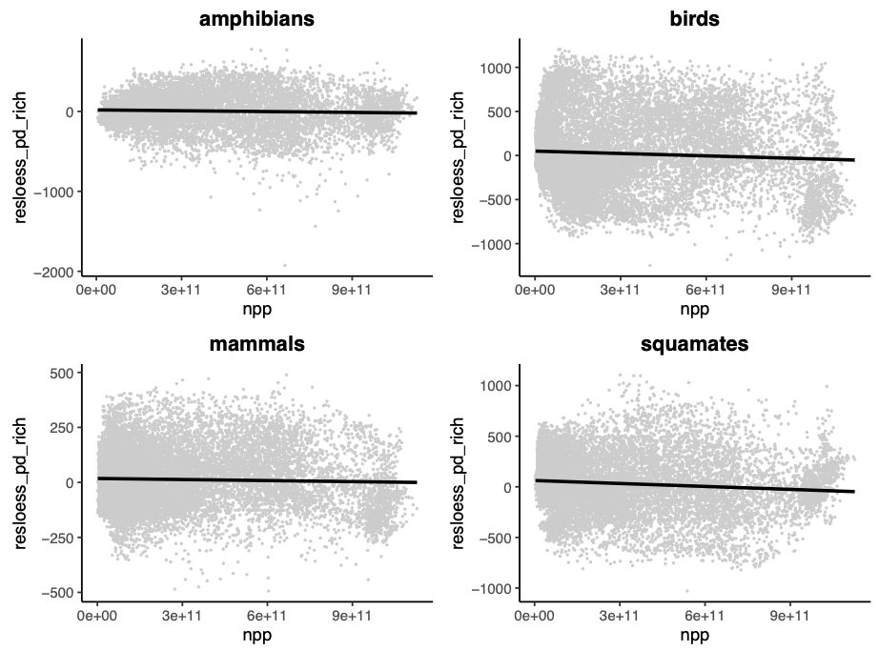
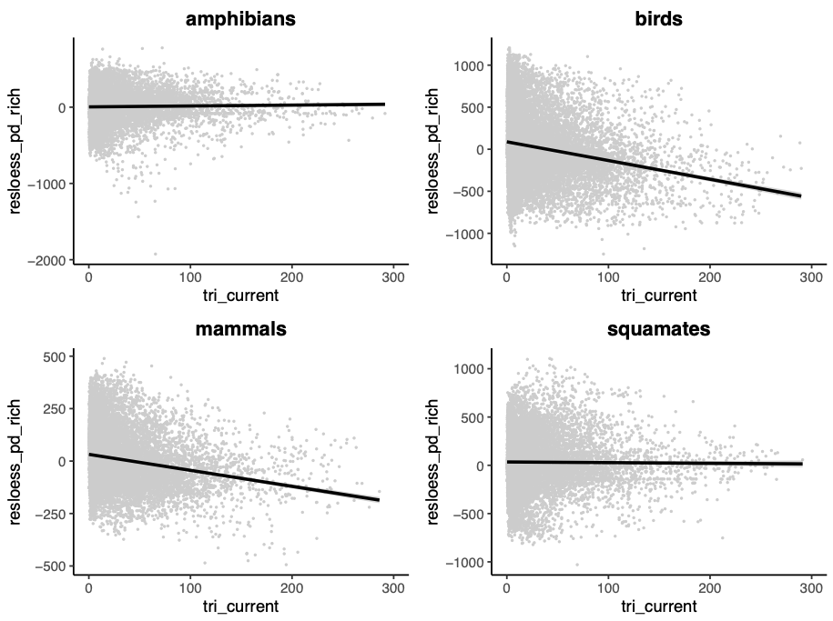
ENVIRONMENT
Net primary productivity
Topographic complexity
R² = 0.0397
R² = 0.002
R² = 0.0004
R² = 0.004
R² = 0.00008
R² = 0.0414
R² = 0.001
R² = 0.01

Slide 25
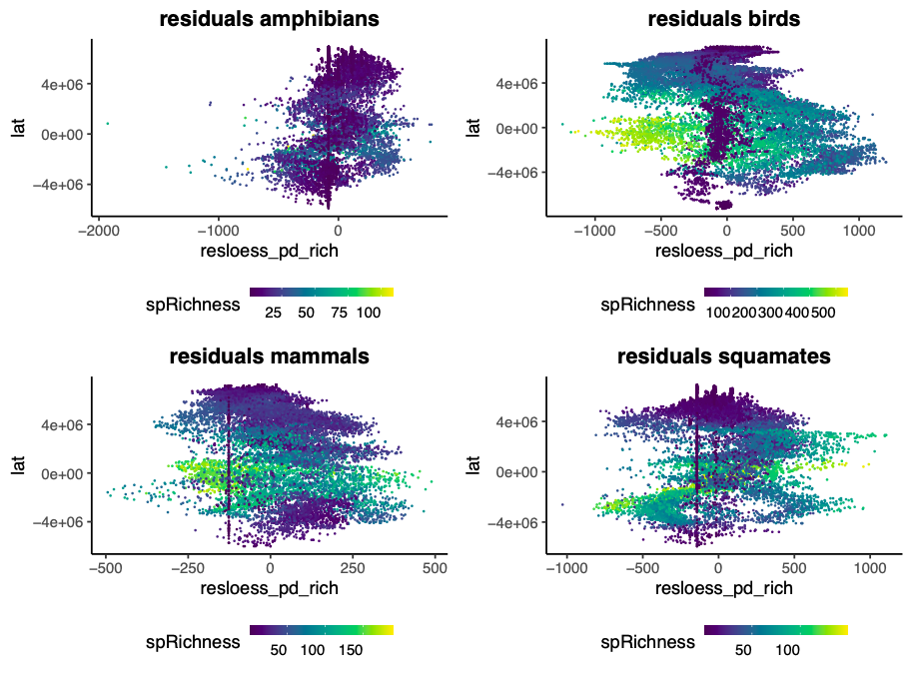
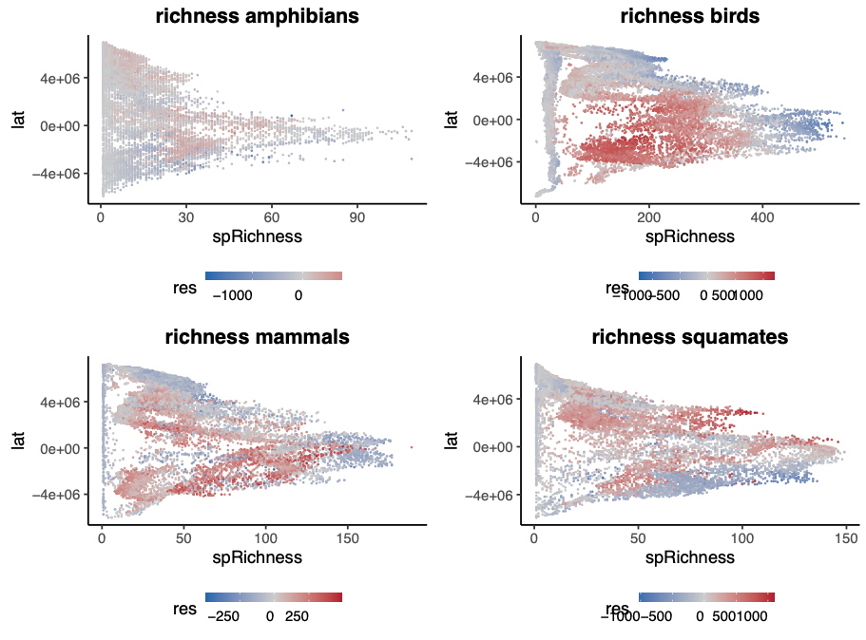
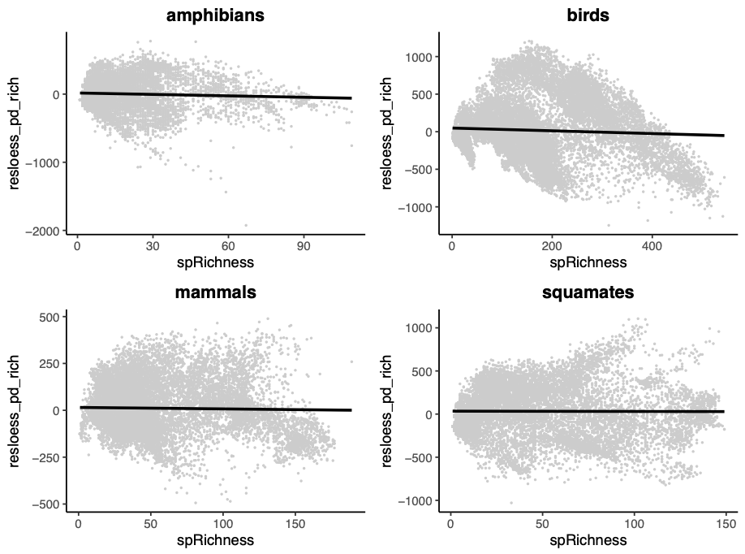
RICHNESS AND LATITUDE
resPD vs latitude (colored by richness)
richness vs latitude (colored by resPD)
richness vs resPD

